Slide 1
Improving Montevideo
An insight on the city venues and services in the Uruguay capital city

Slide 2
About this project
Find ways to improve the city of Montevideo, Uruguay
Authored by Jorge Vallego
Target audience: Government of Montevideo

Slide 3
Data Sources
Municipalities of Montevideo
Venue information from Foursquare Platform
Poll results

Slide 4
Raw Data Sources
https://registronacional.com/uruguay/elecciones/series-electorales-de-municipios-en-uruguay.htm
https://registronacional.com/uruguay/elecciones/circuitos-electorales-en-montevideo.htm
https://municipioe.montevideo.gub.uy/preguntas-frecuentes/donde-estan-ubicados-los-municipios-de-montevideo
https://eleccionesnacionales.corteelectoral.gub.uy/json/Exportaciones/Inf_D_Lema.xlsx

Slide 5
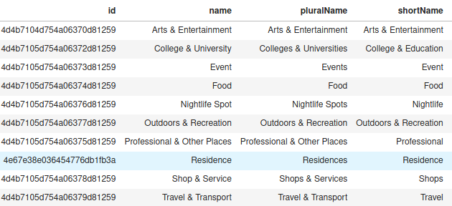
Foursquare Data Example

Slide 6
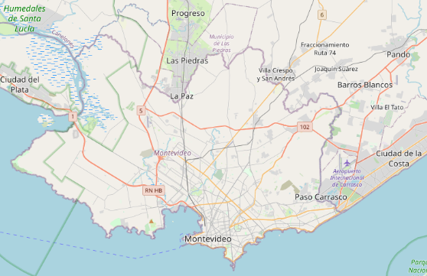
The City

Slide 7
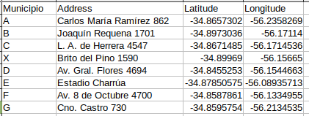
Example of Municipality Curated Data

Slide 8
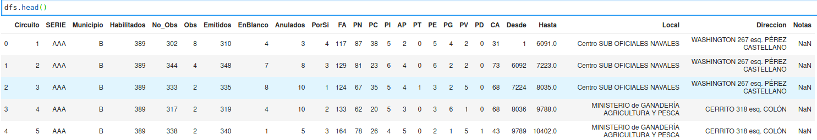
Example of Curated Poll Results

Slide 9
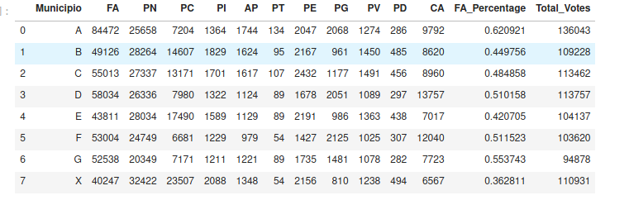
Exploration I
Max Percentage nearly doubles Minimum

Slide 10
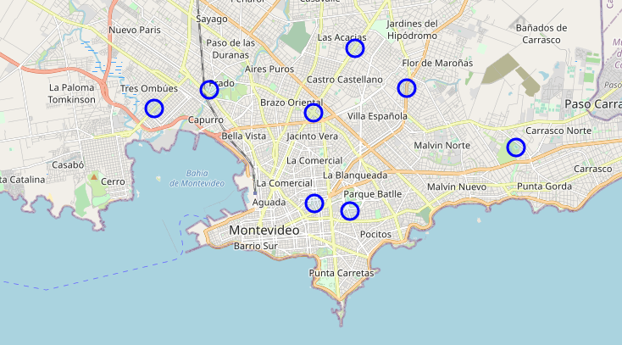
Exploration II
Municipalities in Montevideo

Slide 11
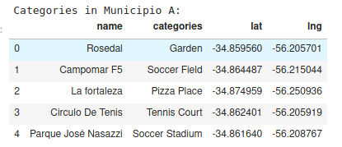
Exploration III
Venue types where the satisfaction is higher

Slide 12
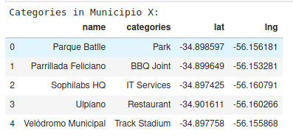
Exploration IV
Venue types where the satisfaction is lower

Slide 13
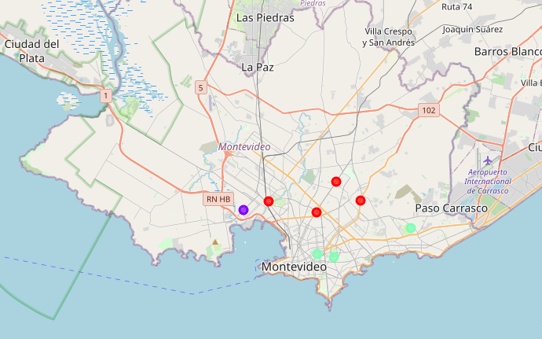
Results – Cluster locations

Slide 14
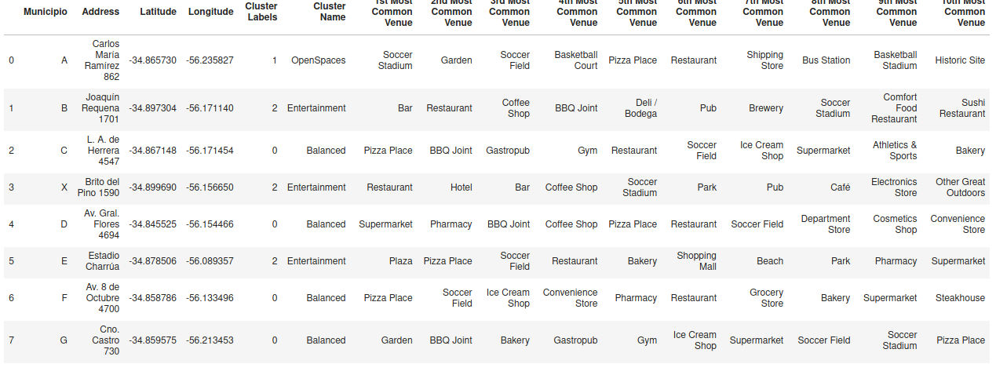
Results – Cluster Summary

Slide 15
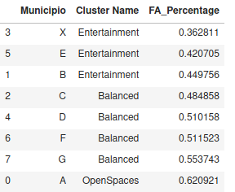
Results – Citizen satisfaction

Slide 16
Discussion
The city can be separated in three main groups
Outdoors
Entertainment
Balanced
The groups are also geographically separated
These groups show differences in type of venues
They also show differences in citizen satisfaction

Slide 17
Conclusion
This study has successfully found patterns
Identified clusters that relate by type of venues
Same clusters also relate to citizen satisfaction
This study will serve the intended purpose
It can be improved further by adding data sources

